Slide 1
Steven Berlanga - Pharmacy System, API, Local Server Carlos Corvaia - Cloud Server, Cloud App Rigoberto Hernandez - Doctor System, Local Server Michael Montaque - Synchronization Algorithm, Local Server Sebastian Zanlongo - Triage System, Local Server, Biometrics
MC-EMR
Mobile Clinic – Electronic Medical Records

Slide 2
Problem Definition
Currently, volunteer physicians are using a paper based system for triaging patients in a mobile clinic that assists at-risk Malawi citizens.
Traveling internationally makes it difficult to keep all the records organized or keep them from being lost.
Orant Charities does not have the time/resources to generate statistics to improve their efforts using the current system.

Slide 3
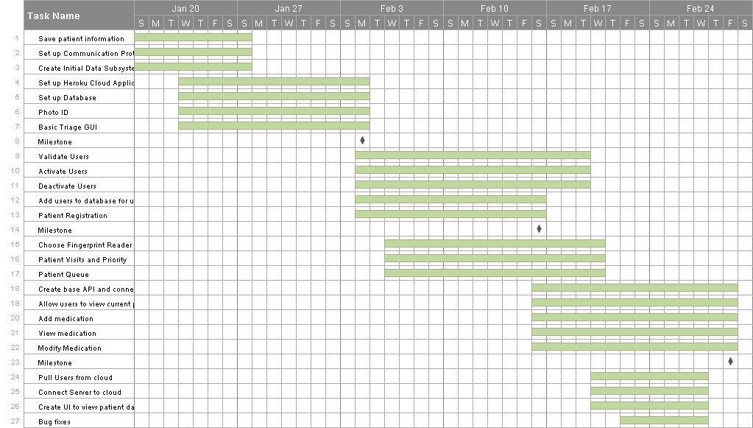
Project Management

Slide 4
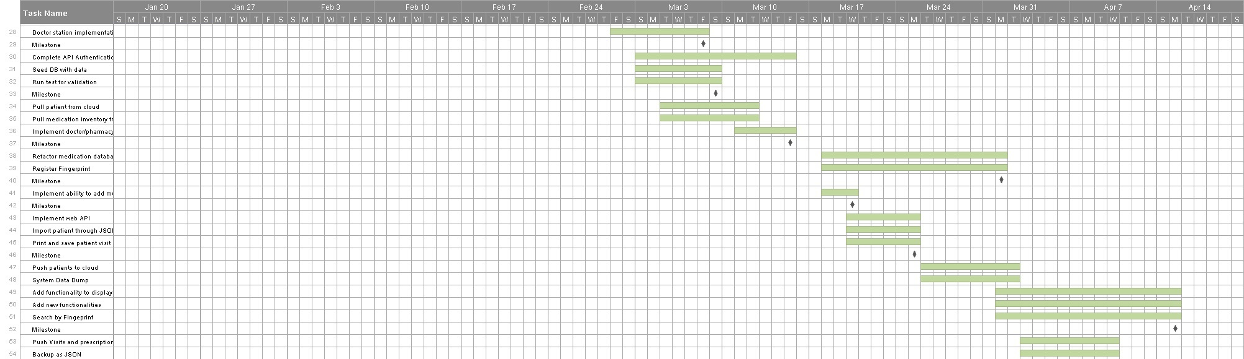
Project Management

Slide 5
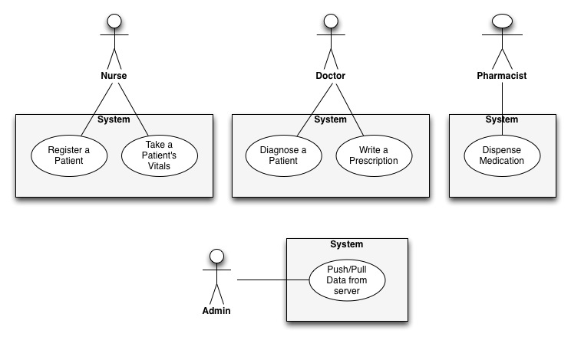
Use Case Diagram

Slide 6






Technologies Used

Slide 7
System Decomposition
Hardware
iPad 2 (3+)
Macbook Air (Local Server)
AirTel MiFi (Internet access)
Heroku Server
Software
iOS 6
Mac OSX 10.8
Ruby on Rails 1.9.3
PostgreSQL Server

Slide 8
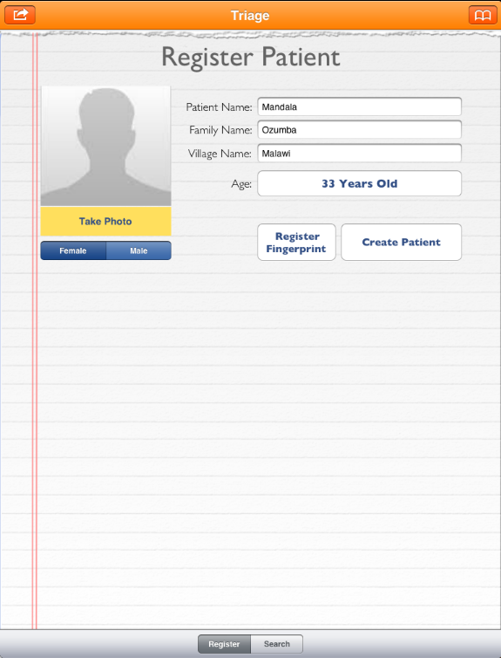
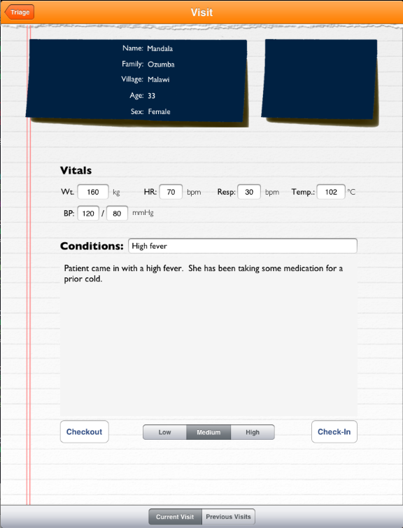
Triage Station

Slide 9
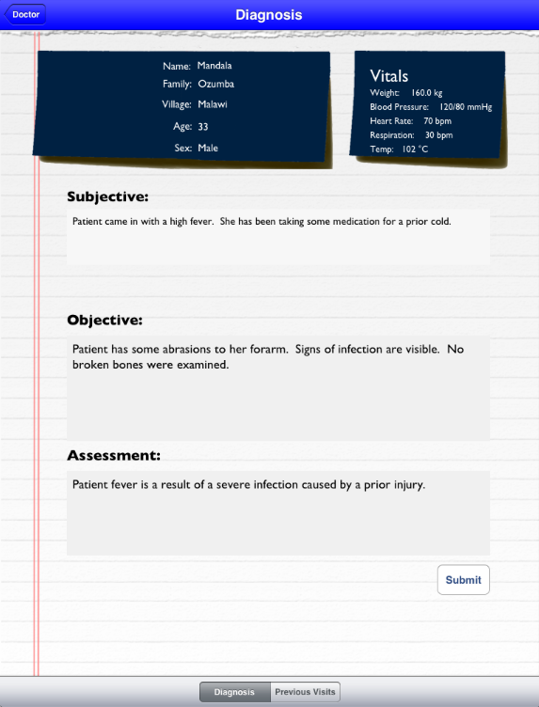
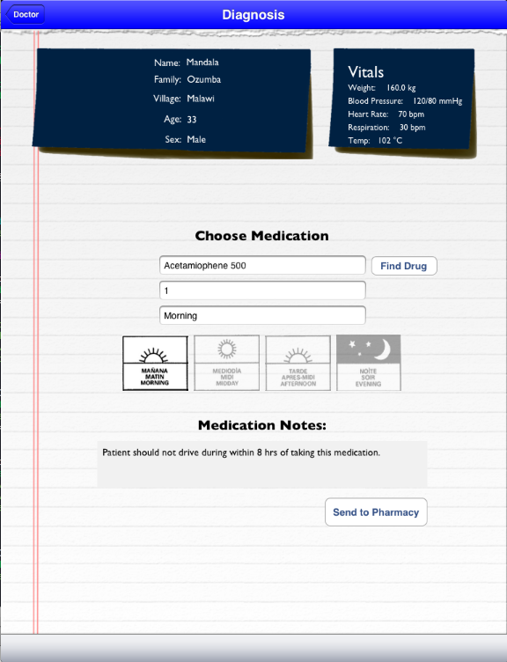
Doctor Station

Slide 10
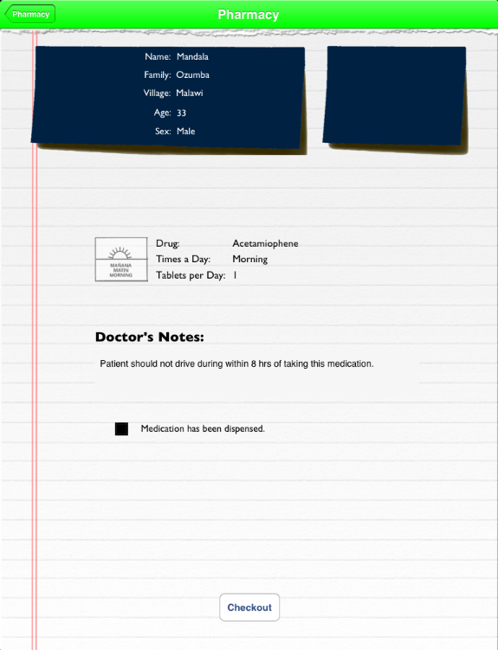
Pharmacy Station

Slide 11
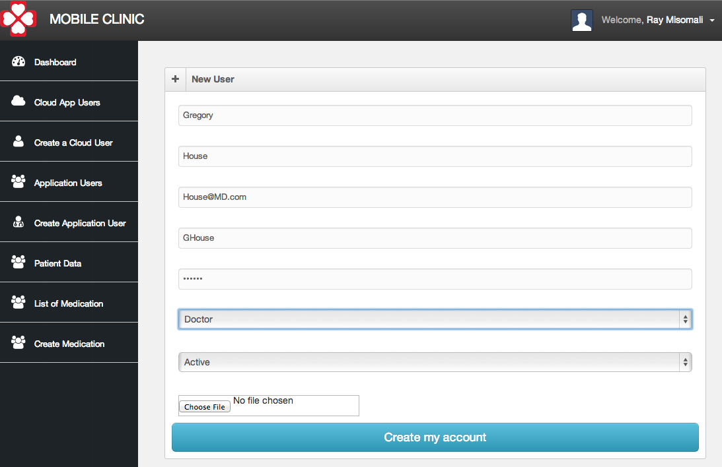

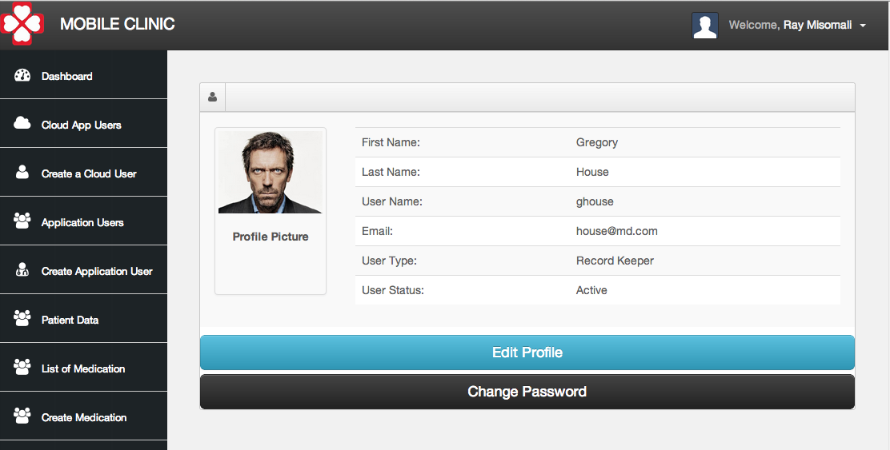
Functional Requirements
US-32
As an Administrator, I want to create a new user so that they have the ability to use the client or local server.
The username & email must not already exist
The usertype must be a be selected from list
Users can only be created through Cloud App

Slide 12
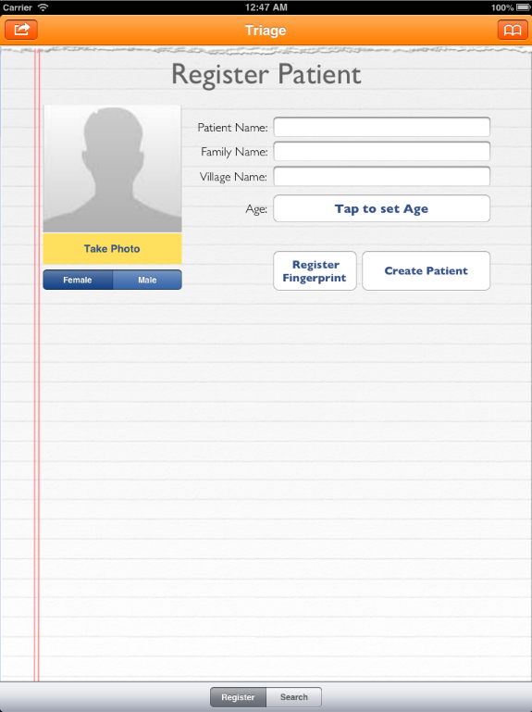
Functional Requirements
US-73
As a Triage nurse, I want to quickly discharge a patient so that other patients with major issues can quickly see the doctor.
The system shall create new patient data if they don't exist
The patient cannot have an open status
The system shall synchronize the patient's information

Slide 13
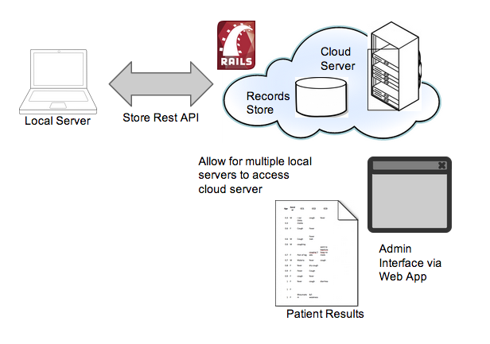
System Decomposition: Cloud Application

Slide 14
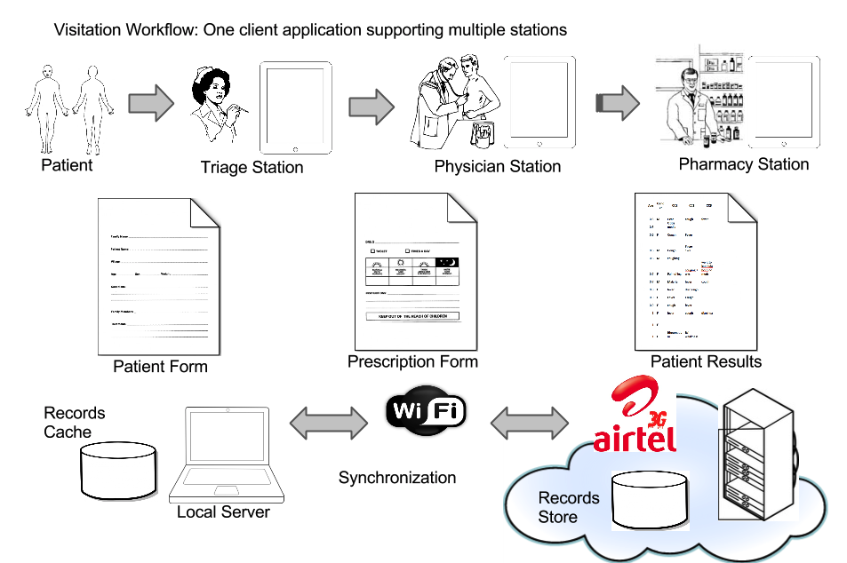
System Decomposition: Local Application

Slide 15
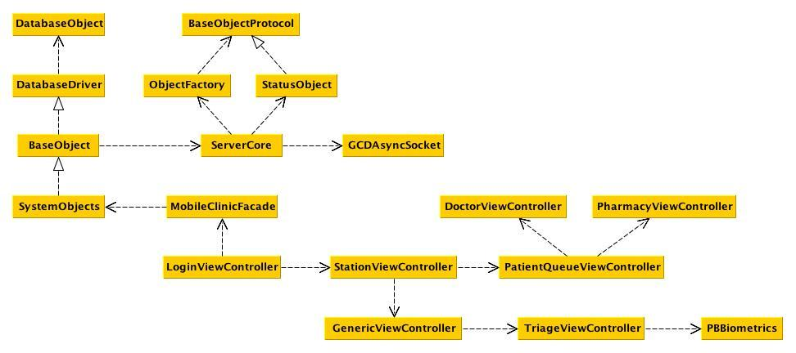
Minimal Class Diagram
Data
(Repository Pattern)
Networking Protocols
Controllers & View

Slide 16
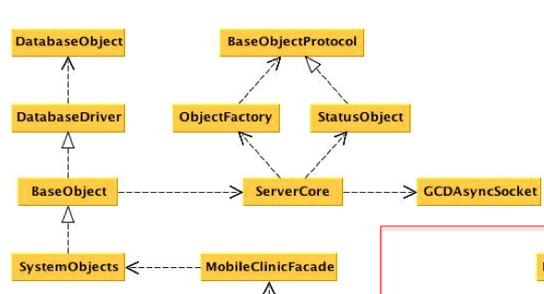
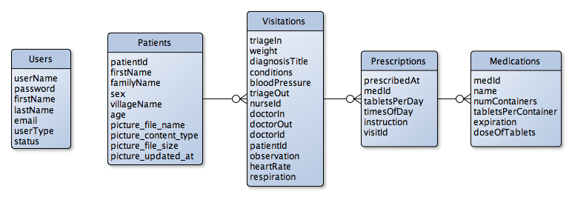
Persistent Data Design
iOS & OSX Core Data
SQLite Database
Repository Pattern

Slide 17
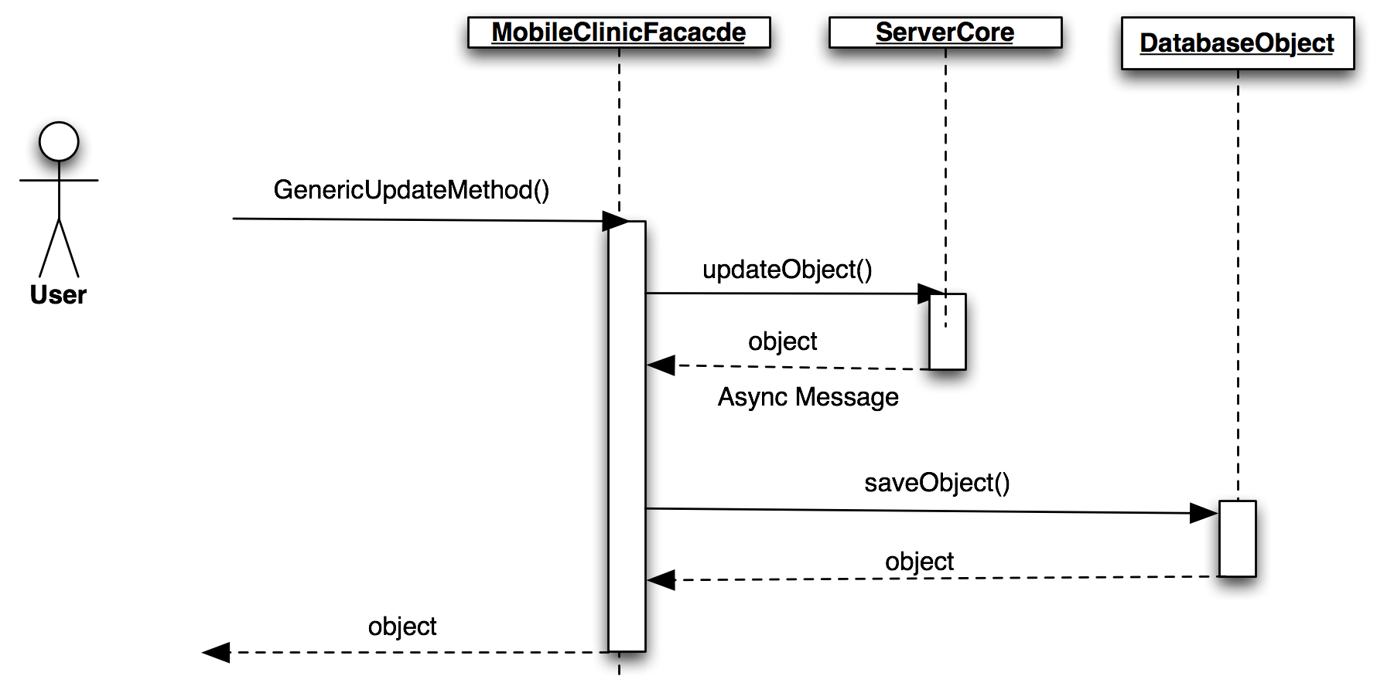


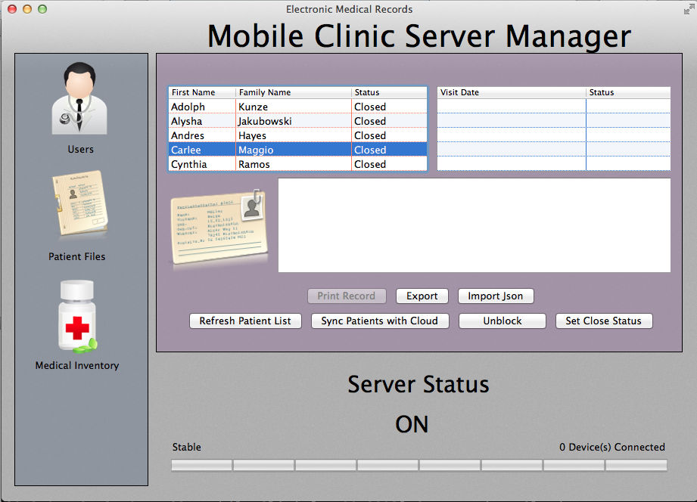
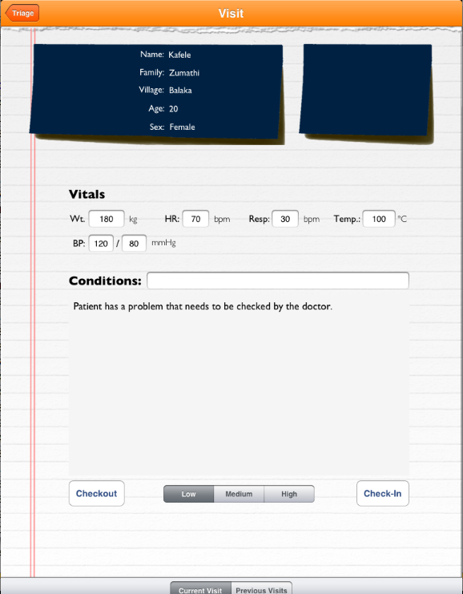
Update Algorithm: Stage 1
Validation
…Received

Slide 18
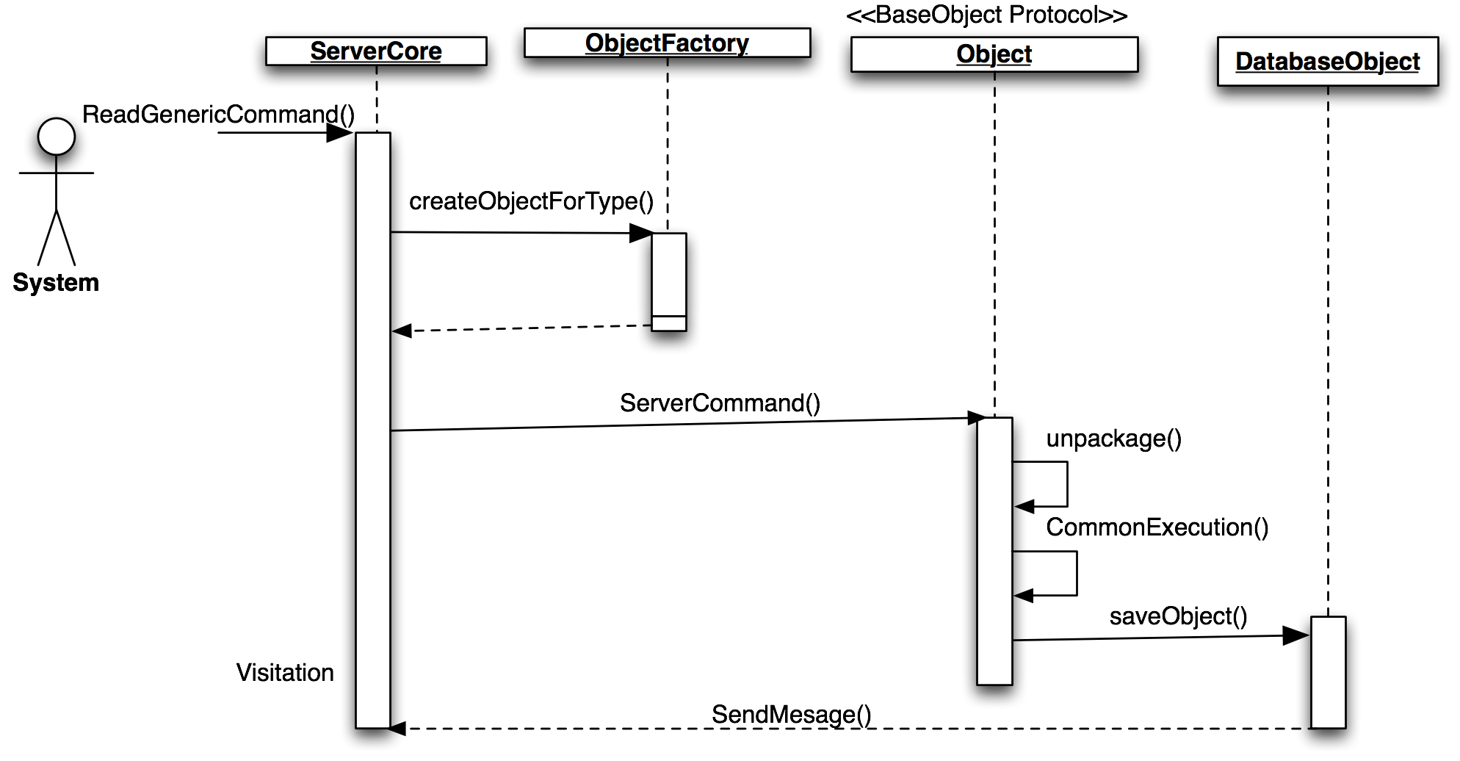
Update Algorithm: Stage 2
Create Patient Object
Command Pattern
(Update)
…Processing
Send Result
Receiving..

Slide 19
Update Algorithm: Final Stage
✔
Received

Slide 20
Security/Privacy
Medical workers required to login with credentials
Log account activity
Account permissions are role-based
Encryption of patient data
API requires authentication
Biometric authentication

Slide 21
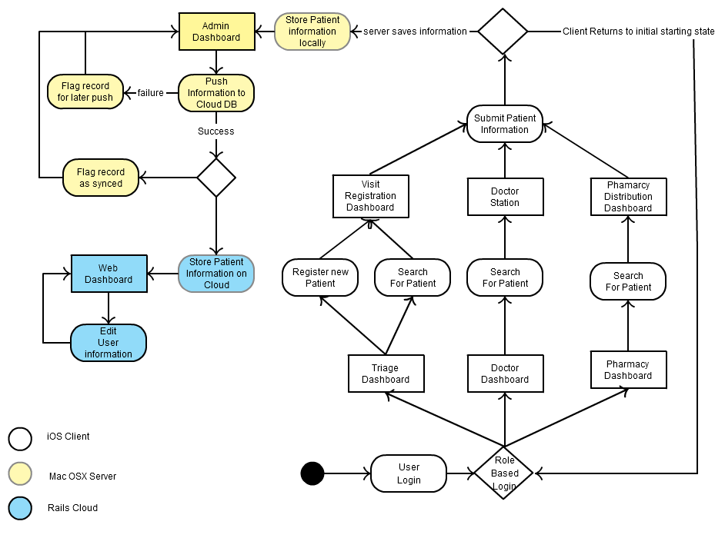
State Machine

Slide 22
Sunny Day Test
Test Case ID | ST-US73-005
Purpose | To ensure that quickly discharging a patient stores the patient data and from said from from the system "Patient Waiting" queue.
Test Setup | -Local server is on and functioning properly -Triage Nurse must be logged into the system. -Triage nurse should have registered a patient and must have recorded patient vitals.
Input | Enter : "Patient has headache." in the conditions field Press "Checkout" button below the conditions field.
Expected Output | The system shall present the Triage Dashboard

Slide 23
Rainy Day Test
Test Case ID | ST-US73-008
Purpose | To ensure that quickly discharging a patient stores the patient data and from said from from the system "Patient Waiting" queue.
Test Setup | -Local Server is not on -Triage Nurse must be logged into the system. -Triage nurse should have registered a patient and must have recorded patient vitals.
Input | Enter : "Patient has headache." in the conditions field Press "Checkout" button below the conditions field.
Expected Output | The system shall present the Triage Dashboard The system shall display an orange banner on the top of the screen saying "Patient Information was not saved to server"

Slide 24
Thank You
Question?

